Slide 1
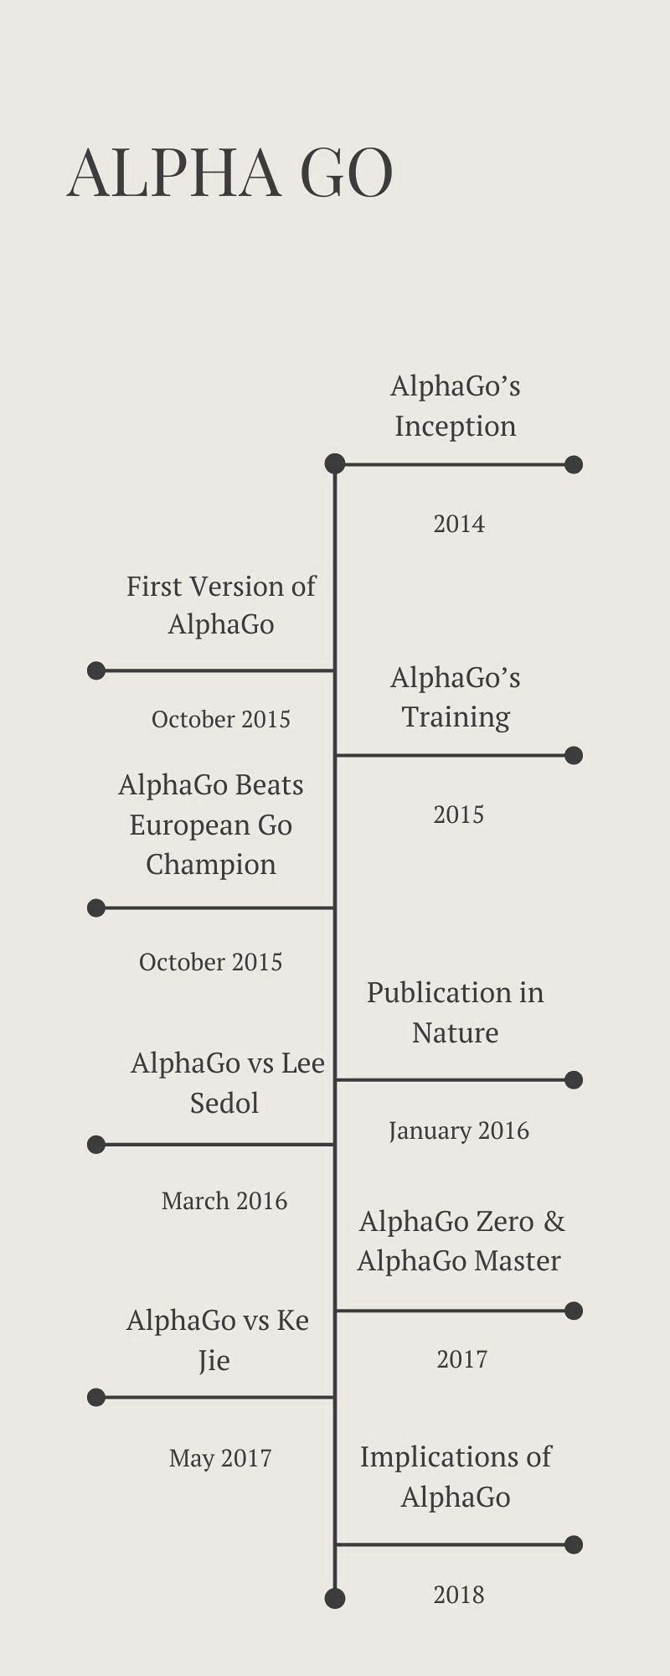
History of AlphaGo (2014-2018)
By: Judith, Omied, Timothy, Aditya, and Vanessa

Slide 2
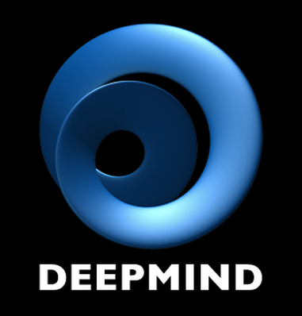
2014
AlphaGo's Inception
DeepMind Technologies, a British AI company founded by Demis Hassabis, Shane Legg, and Mustafa Suleman, starts developing AlphaGo, aiming to create a program capable of mastering the ancient Chinese game of go

Slide 3

October 2015
First Version of AlphaGo
Researchers at DeepMind, including David Silver and Aja Huang, develop the first version of AlphaGo. It uses deep neural networks combined with reinforcement learning including policy networks and value networks

Slide 4
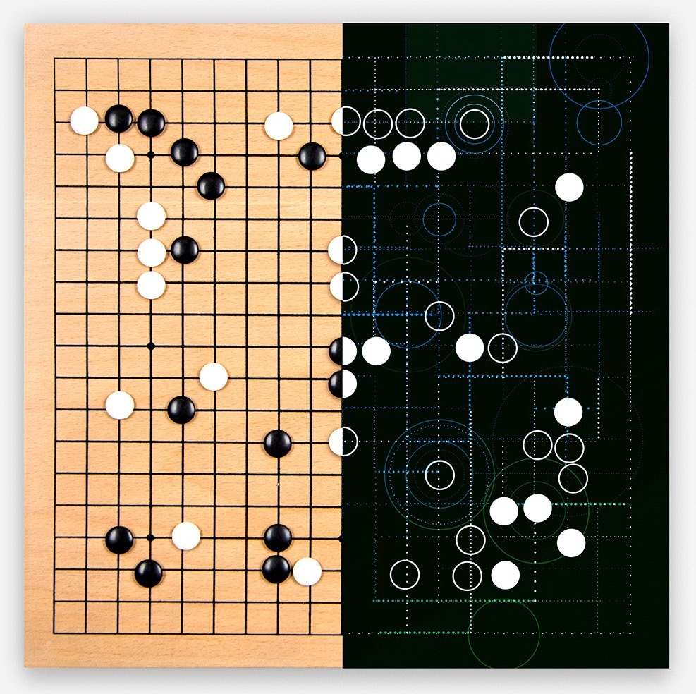
2015
AlphaGo's Training
AlphaGo is trained with more than 30 million moves played by human experts, then it practices against itself using reinforcement learning, playing millions of games to improve its abilities.

Slide 5

October 2015
AlphaGo Defeats European Go Champion
AlphaGo is tested against the European champion, Fan Hui, in a closed door event, AlphaGo wins 5-0, marking the first time an AI program beats a professional Go player.

Slide 6
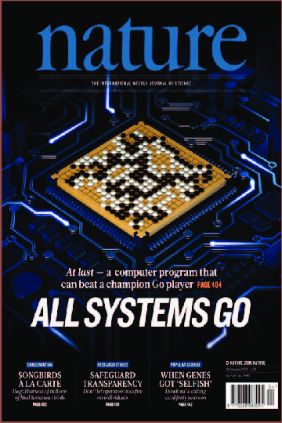
January 2016
Publication in Nature
David Silver and peers publish a paper in the scientific journal Nature, describing AlphaGo and showcasing its success against Fan Hui. This receives worldwide attention from the AI and Go communities.

Slide 7
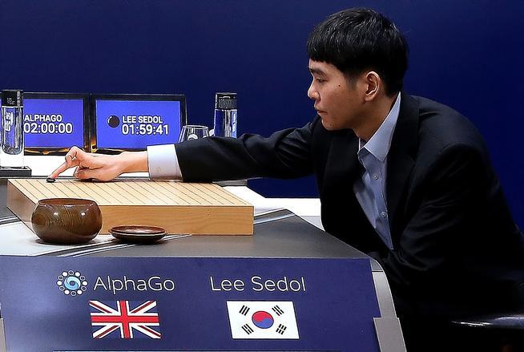
March 2016
AlphaGo vs. Lee Sedol
In a highly anticipated match, AlphaGo faces South Korean legend Lee Sedol, an 18 time world champion. AlphaGo stuns the world in a 4-1 match, showcasing the rapid progress of AI with mastering complex human tasks.

Slide 8
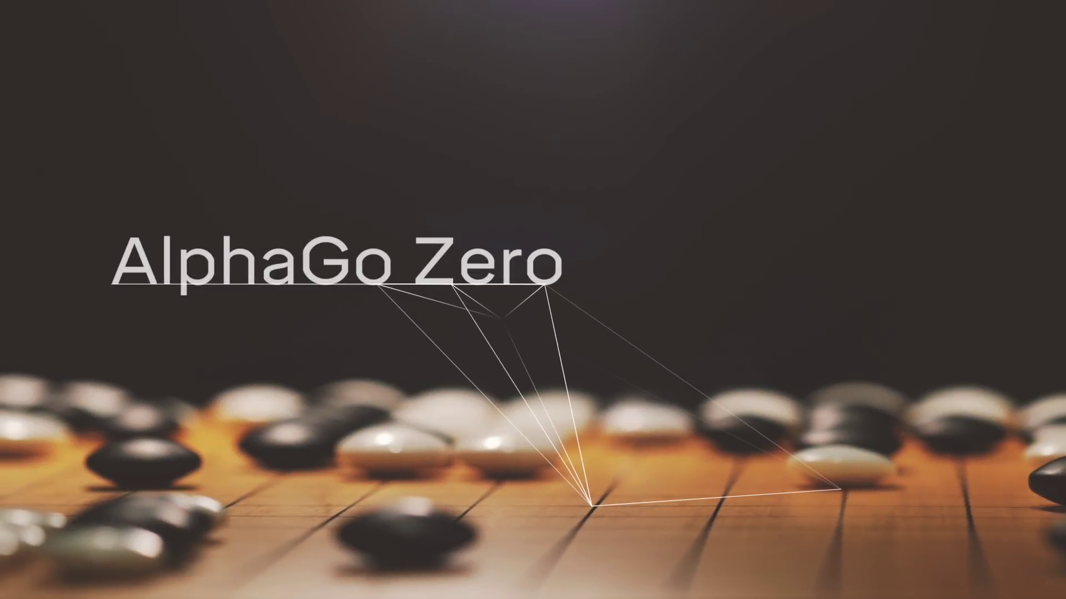
2017
AlphaGo Zero and AlphaGo Master
AlphaGo Master goes online anonymously and wins 60 straight games against top-ranked professional players.
DeepMind reveals AlphaGo Zero, which learns the game from scratch and surpasses previous models in 40 days.

Slide 9
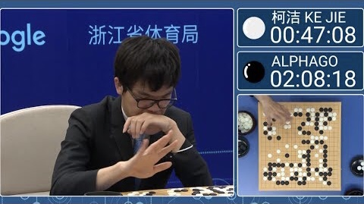
May 2017
AlphaGo vs Ke Jie
AlphaGo faces against Ke Jie, the world champion at the time and wins 2-0 with one draw, showcasing its advancement

Slide 10

2018
Implications of AlphaGo Breakthrough
DeepMind's breakthrough with AlphaGo catapults the field of AI and deep learning, resulting in increased interest and research in reinforcement learning, neural networks, and AI applications across disciplines.
The techniques used in AlphaGo inspires further advancements in AI based systems, including protein folding, drug discovery, and weather forecasting.

Slide 11
bibliography
“AlphaGo.” Wikipedia, Wikimedia Foundation, 27 May 2024, en.wikipedia.org/wiki/AlphaGo.
Google DeepMind. “AlphaGo - the Movie | Full Award-Winning Documentary.” YouTube, YouTube, 13 Mar. 2020, www.youtube.com/watch?v=WXuK6gekU1Y.

